Slide 1
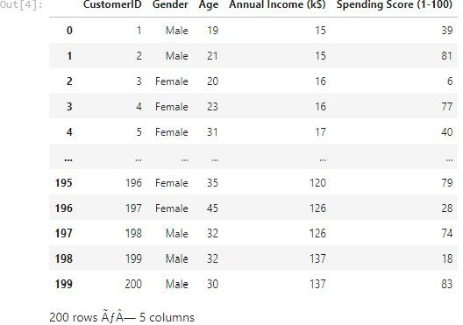
Assignment 4 Python Programming
Assignment Date | 25 Oct 2022
Student Name | Harinee K
Student Roll Number | 923819104013
Maximum Marks | 2 Marks
Question 1:
. Importing Required Package
Solution :
import pandas as pd import numpy as np import seaborn as sbn
import matplotlib.pyplot as plt
Question 2:
. Loading the Dataset
Solution :
db = pd.read_csv('/Mall_Customers.csv') Db
Output
:

Slide 2
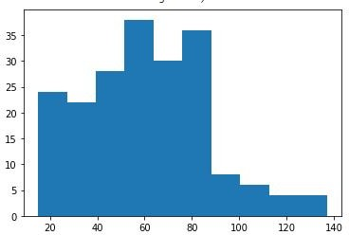
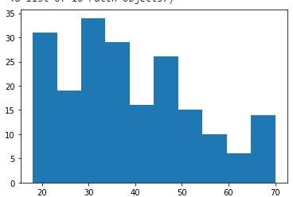
Question 3:
. Visualizations
UniVariate Analysis
Solution : plt.hist(db['Annual Income (k$)'])
Output :
3.1.2 Solution plt.hist(db['Age'])
Output :

Slide 3
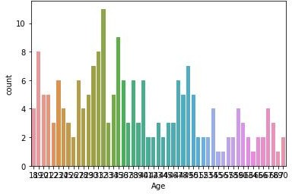
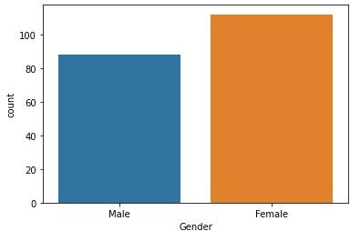
3.1.3 Solution : sbn.countplot(db['Age'])
Output :
3.1.4 Solution :
sbn.countplot(db['Gender'])
Output :
3.1.5 Solution :
plt.hist(db['Spending Score (1-100)'])

Slide 4
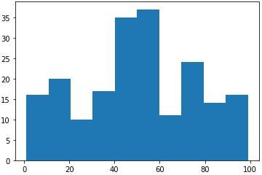
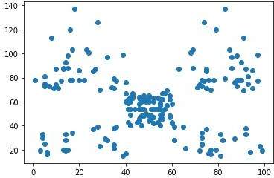
Output :
Bi-Variate Analysis
Solution :
plt.scatter(db['Spending Score (1-100)'],db['Annual Income (k$)'])
Output :
3.2.2 Solution :
plt.scatter(db['Gender'],db['Annual Income (k$)'])

Slide 5
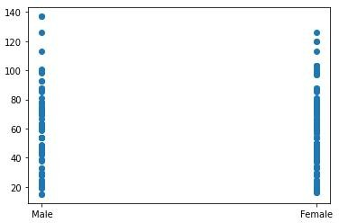
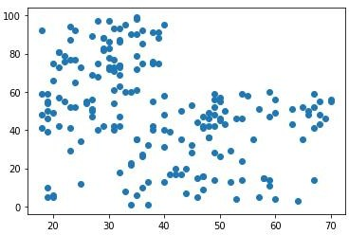
Output :
3.2.3 Solution :
plt.scatter(db['Age'],db['Spending Score (1-100)']) Output :
3.2.4 Solution :
plt.scatter(db['Age'],db['Annual Income (k$)']) Output :

Slide 6
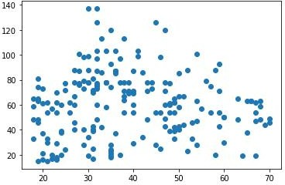
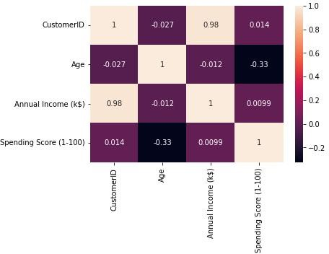
3.2.5 Solution :
sbn.heatmap(db.corr(), annot = True) Output :
3.2.6 Solution :
sbn.barplot(db['Gender'], db['Age'])

Slide 7
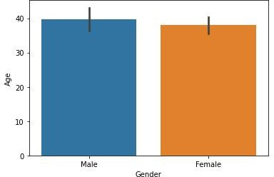
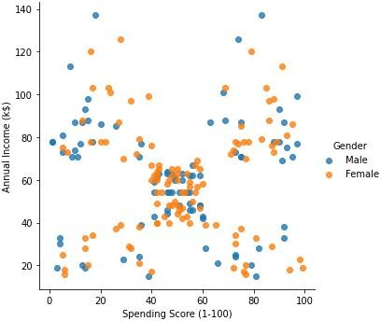
Output :
Multi-Variate Analysis
Solution :
sbn.lmplot("Spending Score (1-100)","Annual Income (k$)", db, hue="Gender", fit_reg=False);
Output :

Slide 8
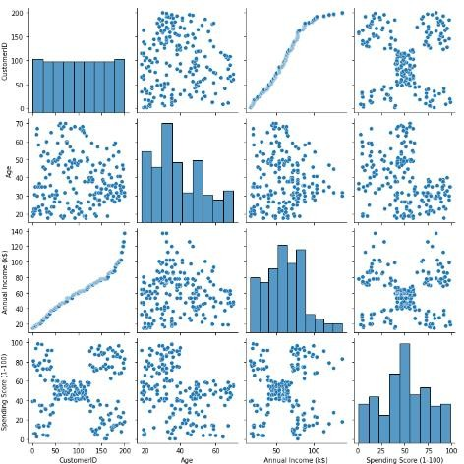
3.3.2 Solution : sbn.pairplot(db)
Output :
Question 4:
. Perform descriptive statistics on the dataset
Solution : db.describe()

Slide 9
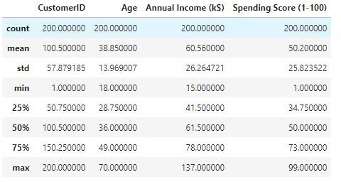
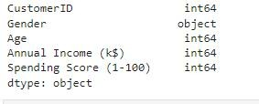

Output :
4.2 Solution :
db.dtypes
Output :
4.3 Solution : db.var()
Output :
4.4 Solution :
db.skew()

Slide 10

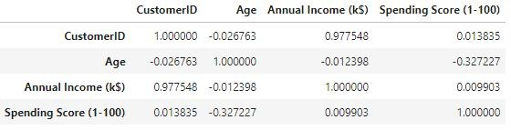

Output :
4.5 Solution :
db.corr()
Output :
4.6 Solution :
db.std() Output :
Question 5:
Check for Missing values and deal with them
Solution :
db.isna().sum()

Slide 11
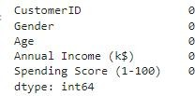
Output :
5.2 Solution :
db.isna().sum().sum() Output :
5.3 Solution :
db.duplicated().sum() Output :
Question 6:
. Find the outliers and replace them outliers
Solution : ig,ax=plt.subplots(figsize=(25,5))
plt.subplot(1, 5, 2) sbn.boxplot(x=db['Age'])
plt.subplot(1, 5, 3) sbn.boxplot(x=db['Annual Income (k$)'])
plt.subplot(1, 5, 4)
sbn.boxplot(x=db['Spending Score (1-100)'])
plt.subplot(1, 5, 1) sbn.boxplot(x=db['CustomerID'])

Slide 12
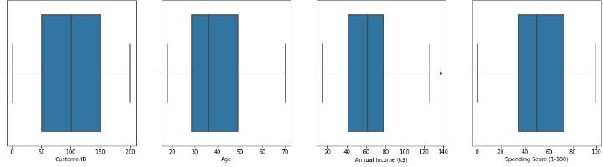


Output :
6.2 Solution :
quantile = db.quantile(q = [0.25, 0.75]) quantile
Output :
6.3 Solution :
quantile.loc[0.75] Output :
6.4 Solution :
quantile.loc[0.25]

Slide 13




Output :
6.5 Solution :
IQR = quantile.iloc[1] - quantile.iloc[0] IQR
Output :
6.6 Solution :
upper = quantile.iloc[1] + (1.5 *IQR) upper
Output :
6.7 Solution :
lower = quantile.iloc[0] - (1.5* IQR) lower
Output :

Slide 14

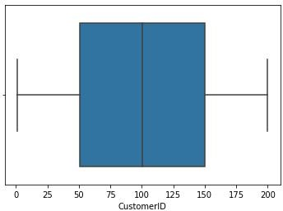
6.8 Solution :
db.mean() Output :
Solution :
db['Annual Income (k$)'].max() Output :
Solution : sbn.boxplot(db['CustomerID']) Output :
6.11 Solution :
sbn.boxplot(db['Age'])

Slide 15
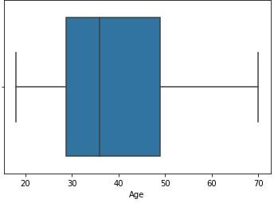
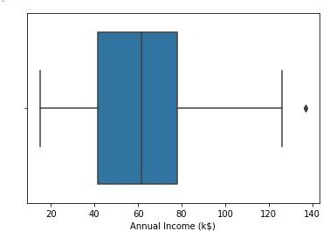
Output :
6.12 Solution :
sbn.boxplot(db['Annual Income (k$)']) Output :
6.13 Solution :
sbn.boxplot(db['Spending Score (1-100)'])

Slide 16
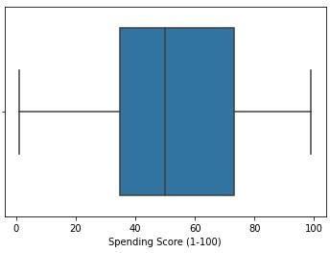
Output :
Question 7:
. Check for Categorical columns and perform encoding
Solution : db.select_dtypes(include='object').columns Output :
Solution :
db['Gender'].unique() Output :
Solution :
db['Gender'].replace({'Male':1,'Female':0},inplace=True) db

Slide 17
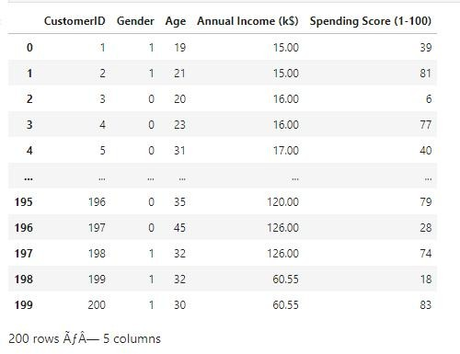
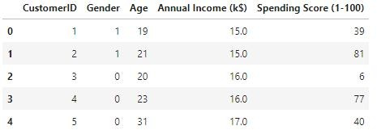
Output :
7.4 Solution : db.head()
Output :
Question 8:
. Scaling the data
Solution :
from sklearn.preprocessing import StandardScaler ss = StandardScaler().fit_transform(db)

Slide 18
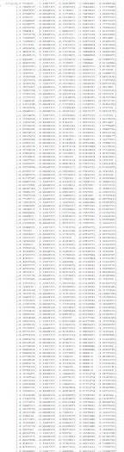
ss
Output :
Question 9:
. Perform any of the clustering algorithms
Solution :
from sklearn.cluster import KMeans TWSS = []
k = list(range(2,9))

Slide 19
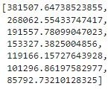
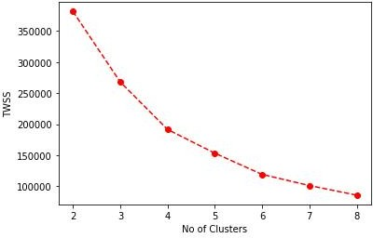
for i in k:
kmeans = KMeans(n_clusters = i , init = 'k-means++') kmeans.fit(db)
TWSS.append(kmeans.inertia_) TWSS
Output :
9.2 Solution :
plt.plot(k,TWSS, 'ro--') plt.xlabel('No of Clusters') plt.ylabel('TWSS')
Output :
9.3 Solution :
model = KMeans(n_clusters = 4) model.fit(db)
Output :

Slide 20
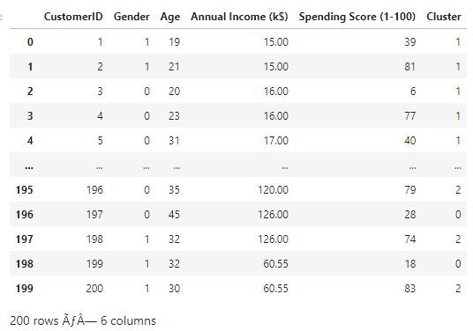
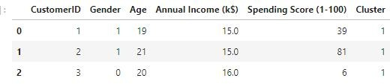
9.4 Solution :
mb = pd.Series(model.labels_) db['Cluster'] = mb
db
Output :
9.5 Solution :
mb=pd.Series(model.labels_) db.head(3)
Output :

Slide 21
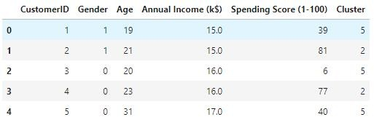
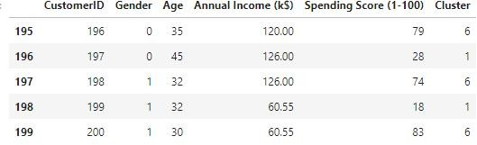
Question 10:
. Add the cluster data with the primary dataset
Solution :
db['Cluster']=kmeans.labels_ db.head()
Output :
10.2 Solution : db.tail()
Output :
Question 11:
. Split the data into dependent and independent variables
Solution :
X=db.drop('Cluster',axis=1) Y=db['Cluster'] y=db['Cluster']
y

Slide 22
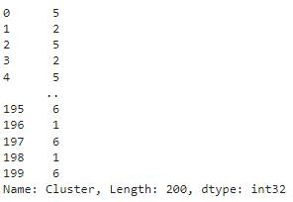

Output :
11.2 Solution :
from sklearn.model_selection import train_test_split X_train,X_test,y_train,y_test=train_test_split(X,Y,test_size=0.2,random_state=42)
print("Number transactions X_train dataset: ", X_train.shape) print("Number transactions y_train dataset: ", y_train.shape) print("Number transactions X_test dataset: ", X_test.shape) print("Number transactions y_test dataset: ", y_test.shape)
Output :
Question 12:
. Split the data into training and testing
Solution : X_train

Slide 23
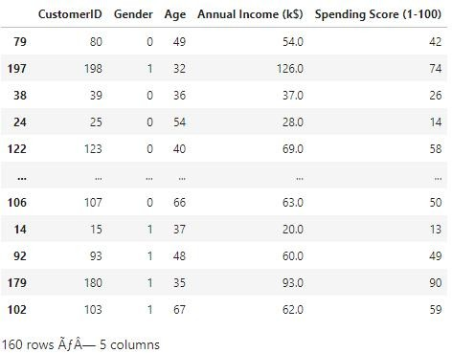
Output :
12.2 Solution :
X_test Output :

Slide 24
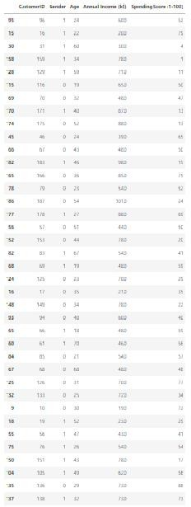
12.3 Solution :
y_train

Slide 25
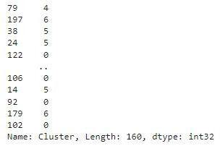
Output :
12.14 Solution :
y_test Output :

Slide 26

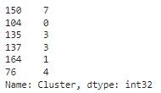
Question 13:
. Build the Model
Solution :
from sklearn.linear_model import LogisticRegression model=LogisticRegression() model.fit(X_train,y_train)
from sklearn.linear_model import LogisticRegression model=LogisticRegression() model.fit(X_train,y_train)

Slide 27
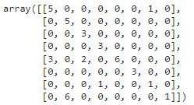
Output :
Question 14:
14 . Train the Model Solution : model.score(X_train,y_train) Output :
Question 15:
15 . Test the Model Solution : model.score(X_test,y_test) Output :
Question 16:
. Measure the performance using Evaluation Metrics
Solution :
from sklearn.metrics import confusion_matrix,classification_report y_pred=model.predict(X_test)
confusion_matrix(y_test,y_pred)
Output :

Slide 28
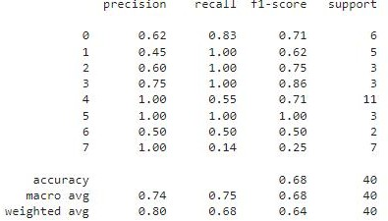
16.2 Solution :
print(classification_report(y_test,y_pred)) Output :

